Slide 1
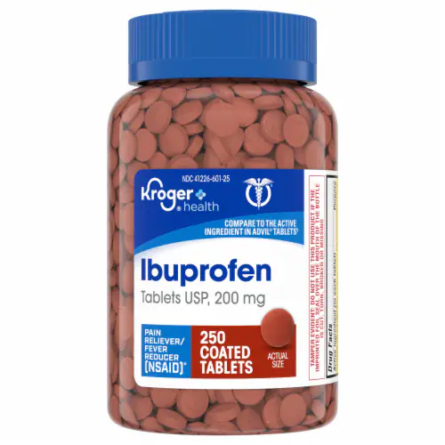
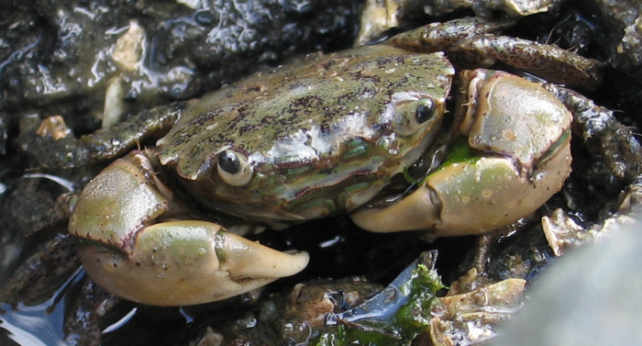
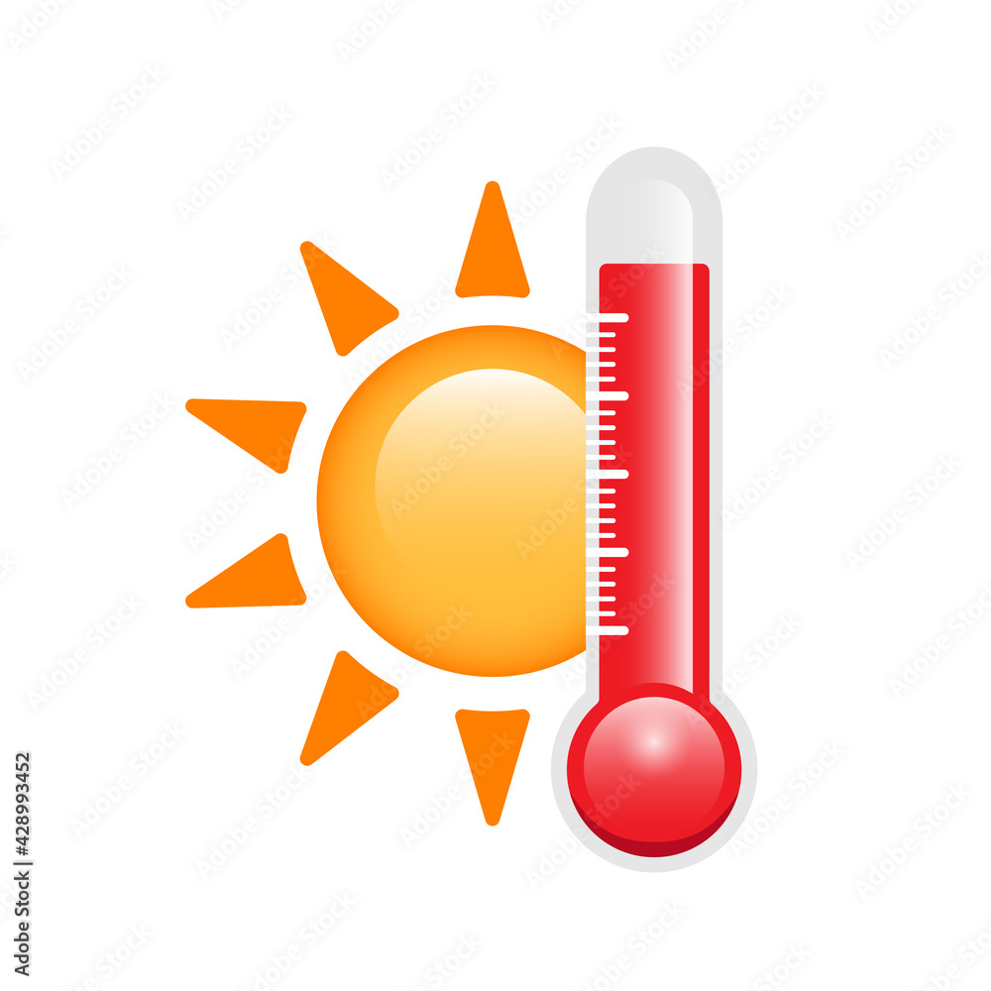
The Ecophysiological Effects of Water Temperature and Ibuprofen on Hemigrapsus oregonensis
Jolee Thirtyacre, Jason Ray, Alexias Thao

Slide 2
Introduction
Topic:
Combined effects of increased water temperature and ibuprofen and the effect it has on H. oregonensis physiology
Importance:
Presence of pharmaceuticals have been in aquatic systems for decades, only recently has there been a push to closely examine the concentrations (Fernandes et al. 2021)
H. oregonensis face multiple stressors in their natural environment
Low tide → increased temperatures
Runoff → contaminated water + accumulation of pharmaceuticals in water and sediment

Slide 3
Background/Relevance
Temperature
Global increases in temperature
Near-shore species are strongly impacted
Ibuprofen
Consumed at high rates (180 tons per year - Germany)
After wastewater treatment, residual ibuprofen is still prevalent
Combined Effects
Temperature is known to impact toxicity of chemicals
Other NSAIDs designated at “harmful” have “toxic” statuses with increased temperatures
Lack of research on the combined effects - most research is temperature OR ibuprofen

Slide 4
Research Questions
How will increasing concentrations of ibuprofen affect glucose and respiration rates in H. oregonensis?
How will an increase in temperature affect glucose and respiration rates in H. oregonensis?
How will the combined effects of ibuprofen concentrations and increased temperature affect glucose and respiration rates in H. oregonensis?

Slide 5
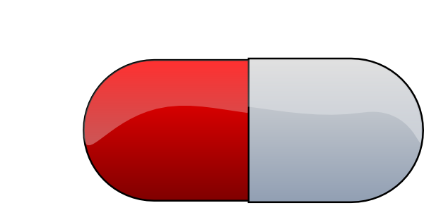
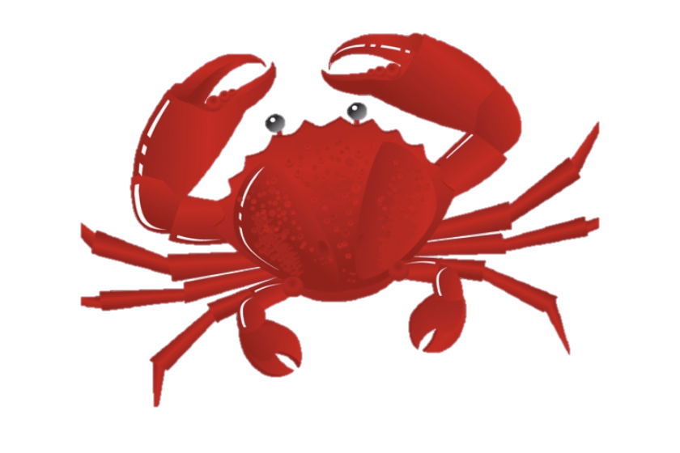
Hypotheses
Glucose
Respiration
Experimental
Control

Slide 6
Experimental Design
High Temperature (27 ⁰C)
Ambient Temperature (13 ⁰C)
Ibuprofen -
low dose (6.25 μg/L)
Ibuprofen -
high dose (31.25 μg/L)
3 replicates
6 crab in each drug treatment
Experimental
Control

Slide 7
Methods
Oxygen consumption → resazurin each week
30 min
60 min
90 min
Used 1 crab from each treatment as representative
Graphed for visualization of results across weeks
Glucose levels → hemolymph extraction on the last day
Average of all crabs from each treatment
Tank cleaning each week
Re-dosed tanks after cleaning

Slide 8
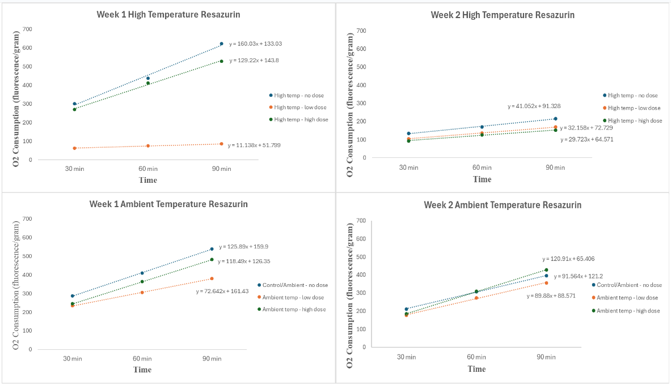
Results - Resazurin

Slide 9
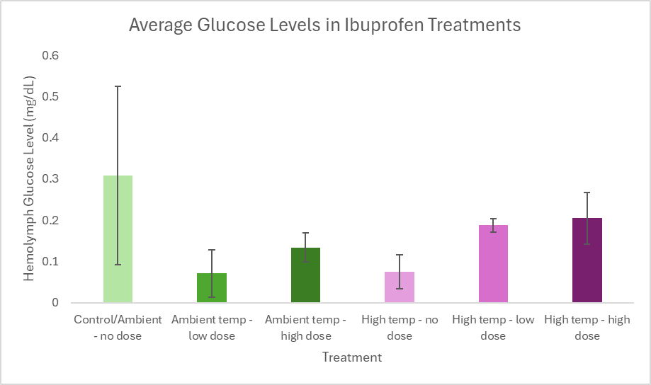
Results - Hemolymph Glucose

Slide 10
Interpretations/Conclusions
NSAIDS combined with thermal stress reduce oxygen consumption due to fatigue and energy depletion.
Exposure to NSAIDS depletes glucose levels especially at ambient temperature OR glucose production is lower in ambient temperatures
One week heat exposure elevates O2 consumption but two week heat exposure suppresses O2 consumption.
Notes:
Yang et al. 2020 found that fish exposed to NSAIDS and thermal stress reduced oxygen consumption due to fatigue and energy depletion
Rodrigues et al. 2015 showed European green crab(Carcinus Maenus) that had short term heat exposure had elevated O2 consumption but long term heat exposure suppressed O2 consumption. We see a similar pattern week over week with our higher temperature treatments respirating less than ambient treatments.
Trombini et al. 2021 showed depleted glucose levels in crayfish (Procambarus clarkii) exposed to NSAIDs. All Ibuprofen treatments in our experiment had substantially lower glucose then the control.

Slide 11
Limitations
Small amount of replicates could explain high variance
Singular Hemolymph assay at the end of week two doesn’t give us a reference point for interpretation of results
Sexes of crabs weren’t considered which could explain mixed results due to how females mobilize glucose during stress
Notes:
Chang et al. 1998 = female crabs naturally have a lower glucose response under stress (vs males) = The female crabs have a lower baseline and their glucose mobilization is blunted during stress when exposed to ibuprofen (Aguirre-Martínez et al. 2013) = More females would show lower glucose levels then males

Slide 12
Future Work
Next steps:
Long-term drug studies (chronic response - Fent et al. 2006)
Drug mixture studies (how combined drugs change physiology - Nieto et al. 2016)
Tissue response to drugs (gill, cell damage - Aguirre-Martinez et al. 2013)
Unanswered questions:
Does the type of ibuprofen used impact crab response (e.g., liquid form)?
Is there a threshold where ibuprofen appears to be beneficial?
How might these crabs have responded over a longer period of exposure?
Potential applications:
Shore crabs such as H. oregonensis are early signals for how marine organisms can be affected by both increased temperature and ibuprofen

Slide 13
References
Articles:
Aguirre-Martínez, G. V., Del Valls, T. A., & Martín-Díaz, M. L. (2013b). Identification of biomarkers responsive to chronic exposure to pharmaceuticals in target tissues of Carcinus maenas. Marine Environmental Research, 87–88, 1–11. https://doi.org/10.1016/j.marenvres.2013.02.011
Chang, E. S., Keller, R., & Chang, S. A. (1998). Quantification of crustacean hyperglycemic hormone by Elisa in hemolymph of the lobster,homarus americanus,following various stresses. General and Comparative Endocrinology, 111(3), 359–366. https://doi.org/10.1006/gcen.1998.7120
Fent, K., Weston, A., & Caminada, D. (2006). Ecotoxicology of human pharmaceuticals. Aquatic Toxicology, 76(2), 122–159. https://doi.org/10.1016/j.aquatox.2005.09.009
Fernandes, J. P., Almeida, C. M., Salgado, M. A., Carvalho, M. F., & Mucha, A. P. (2021). Pharmaceutical compounds in aquatic environments—occurrence, fate and bioremediation prospective. Toxics, 9(10), 257.
Nieto, E., Hampel, M., González-Ortegón, E., Drake, P., & Blasco, J. (2016). Influence of temperature on toxicity of single pharmaceuticals and mixtures, in the crustacean A. desmarestii. Journal of Hazardous Materials, 313, 159–169. https://doi.org/10.1016/j.jhazmat.2016.03.061
Rodrigues, A. P., Santos, L. H. M. L. M., Ramalhosa, M. J., Delerue-Matos, C., & Guimarães, L. (2015). Sertraline accumulation and effects in the estuarine decapod carcinus maenas: Importance of the history of exposure to chemical stress. Journal of Hazardous Materials, 283, 350–358. https://doi.org/10.1016/j.jhazmat.2014.08.035
Trombini, C., Kazakova, J., Montilla-López, A., Fernández-Cisnal, R., Hampel, M., Fernández-Torres, R., Bello-López, M. Á., Abril, N., & Blasco, J. (2021). Assessment of pharmaceutical mixture (Ibuprofen, ciprofloxacin and flumequine) effects to the crayfish procambarus clarkii: A multilevel analysis (biochemical, transcriptional and proteomic approaches). Environmental Research, 200, 111396. https://doi.org/10.1016/j.envres.2021.111396
Yang, C., Song, G., & Lim, W. (2020). A review of the toxicity in fish exposed to antibiotics. Comparative Biochemistry and Physiology Part C: Toxicology &amp; Pharmacology, 237, 108840. https://doi.org/10.1016/j.cbpc.2020.108840
Photos:
https://www.kroger.com/p/kroger-ibuprofen-tablets/0004126001301?fulfillment=PICKUP&searchType=default_search
https://wsg.washington.edu/hemigrapsus-oregonensis-jaws/
https://stock.adobe.com/uk/images/thermometer-and-sun-hot-weather-and-high-temperature-illustration-vector-illustration/428993452

